Slide 1
Next Generation Packaging, Kitting, and Palletizing: Can one robot do it all?
MODEX 2012
Sponsored by:
The National Institute of Standards and Technology (NIST)

Slide 2
Logistics
Please sign in!
Restrooms are out the door and to the right
Coffee break
Timing

Slide 3
Next Generation Packaging, Kitting, and Palletizing: Can one robot do it all? 2/9/2012 9:00 AM - 1:00 PM
Time | Speaker & Topic
9:00 AM | Welcome & Introduction: Stephen Balakirsky (NIST)
9:15 AM | Meeting the Challenges of Mixed Case Palletizing in Production: Larry Sweet (C&S Wholesale Grocers)
9:40 AM | One Robot CAN Do It All: David Peters (Universal Robotics, Inc.)
10:05 AM | Erik Nieves (Yaskawa America, Inc., Motoman Robotics Division)
10:30 AM | Coffee Break (Refreshments will be provided)
11:00 AM | Exploiting Robotic Flexibility: Successes, Challenges, and Opportunities: Dick Motley (Fanuc Robotics America)
11:25 AM | Automated Robot Order Assembly: Christian Wurll (KUKA Systems North America)
11:50 AM | Panel Discussion
12:50 PM | Closing Remarks & Wrap-up
1:00 PM | Adjourn

Slide 4
Why NIST
The National Institute of Standards and Technology is interested in developing performance measurement techniques and standards that will enable US industry to become even more competitive
Conversations with industry have shown the need for robotic systems that are:
“Easily “ reconfigured
Able to operate in unstructured environments
Able to operate in conjunction/cooperation with humans (i.e. not caged–off from them)
In other words, more agile
One potentially promising area for standards development in support of agile robotics is in the areas of packaging, kitting, and mixed palletizing
NIST is embarking on a project to address this area and it is critical that the project align with real industry needs

Slide 5
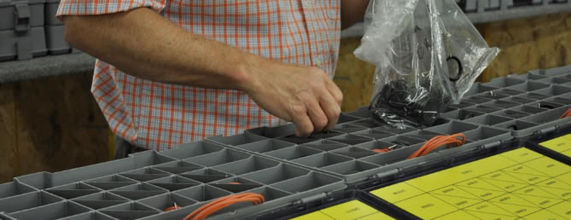
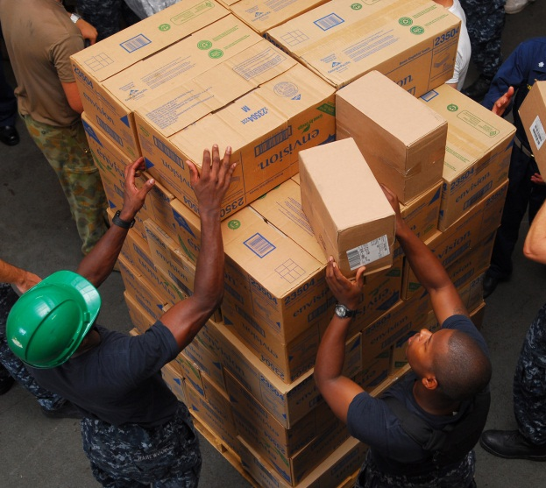
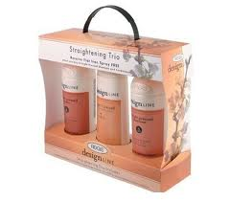
Many Communities – One Data Representation?
Can a uniform data representation be developed to service all communities in:
Order data
Plan data
Environmental information
Performance evaluation
Can this representation cope with unstructured environments and work around people
Can it be sharable between humans and robots
Part movement and component placement are needed by a large variety of communities
“Kitting” – Staging materials used for assembly process
Packaging – Placing components into set configurations inside containers
Palletizing – Placing components onto pallets for shipment or movement

Slide 6
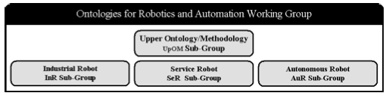
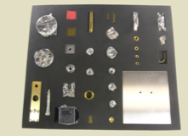
IEEE RAS Ontologies for Robotics and Automation (ORA) Working Group
Goal: To develop a methodology for knowledge representation and reasoning in robotics and automation, together with the representation of concepts in an initial set of application domains, to allow for unambiguous knowledge transfer among any group of humans, robots, and other artificial systems.
Approved by IEEE in Sept 2011
Participants: 125 international members representing academia, industry and government
Timeline: draft standards for the upper ontology and industrial robots in CY2013
To get involved:
Join our mailing list https://groups.google.com/forum/ #!forum/ieeeraswg
Come to our working meetings at ICRA and IROS
Speak with us after this workshop
Initial focus on kitting / assembly / material handling

Slide 7
NIST’s Belief, What’s Yours?
A uniform data representation is possible and will
Promote agility
Enable market penetration of robotic systems into more manufacturing facilities (including small and mid-sized operations)
Standard performance measures will give end-users the confidence needed to purchase and implement these systems
Agile robotic systems in facilities will lower operating costs and make the end-users more competitive

Slide 8
We Are Here To Listen
NIST is neither a Government regulator nor the expert in the room on this topic
This seminar gathers leaders from the end-user, algorithm development, and robot vendor communities
During the talks and panel discussions, we hope to hear about real-world problems, solutions, and areas of opportunity for collaboration and cooperation
Our end-product for this workshop will be a white-paper that summarizes the discussions and proposes suggested next steps
We hope that this is the beginning of a relationship that will produce more agile and robust robotic solutions for industry

